Slide 1
SafeRoute Shield
Automated Accident Reporting and Tracking System
Presented By,
922120106028 - KARAN M
922120106033 - LATHEEP MAIDEEN A
SSM INSTITUTE OF ENGINEERING AND TECHNOLOGY
DINDIGUL
Guided By,
Dr.S.MADHAVAPANDIAN
DESIGN LEAD
TESSOLVE SEMICONDUCTOR PVT. LTD

Slide 2
AGENDA
Abstract
Introduction
Objective
Literature Survey
Existing Method
Proposed work
Hardware
Pin Configuration
Software
Application
Project Demo
Conclusion
Reference

Slide 3
ABSTRACT
The "SafeRoute Shield" is a project aimed at addressing the increasing road accidents caused by high traffic and reckless driving. The system combines a Vehicle Tracking and Accident Notification System to enhance road safety. Using GPS and GSM technologies, it continuously tracks vehicles in real-time, ensuring their security. In case of accidents, the system quickly notifies family members and ambulance authorities, reducing critical delays in providing medical aid. Advanced sensors, including Accelerometer, Vibration Sensor, Alcohol Sensor, and Sound Sensor, detect accidents promptly. The integration of Intel Galileo Gen 2 board enhances the efficiency and reliability of the solution. Overall, SafeRoute Shield proactively prevents mishaps on the roads and contributes to public safety

Slide 4
INTRODUCTION
In India, road travel is widely popular, but the condition of roads is a concern due to increasing traffic and accidents. To address this, our proposed system uses advanced sensors to detect accidents quickly and sends alerts to authorities and the victim's family via SMS, ensuring swift emergency responses. This technology aims to enhance road safety and mitigate the impact of accidents in a fast-paced urban environment.

Slide 5
OBJECTIVE
Implement various sensors to detect accidents.
Locate the accident spot using GPS technology.
Immediate alert on accidents using GSM technology.
Security to vehicles by tracking them.
Demonstrate Alerts Mechanism to Family Members.
Enhance Road Safety.

Slide 6
LITERATURE SURVEY
S.NO | TITLE | AUTHOR | DISADVANTAGES
1 | Vehicle Tracking and Accident Notification System | Racheal Dias, Vishakha Ghike, Jennifer Johnraj, Nicholas Fernandes, Anita Jadhav | 1.Sensor Limitations- Struggle To detect Accurately 2.Arduino Uno Processing Limits - processing power and capability, potentially affecting the speed and efficiency of data processing. 3.Compatibility and Integration Constraints-integration of sensors with Arduino Uno may restrict the overall flexibility and expandability of the system.
2 | Accident Alert and Vehicle Tracking System | Dr. Avinash Chandra, Rishab Kaul, Shaanvi Mehta, Subharthi Saha
3 | Accident Alert and Vehicle Tracking System using GPS and GSM | J. Mounika N. Charanjit B. Saitharun & B. Vashista

Slide 7
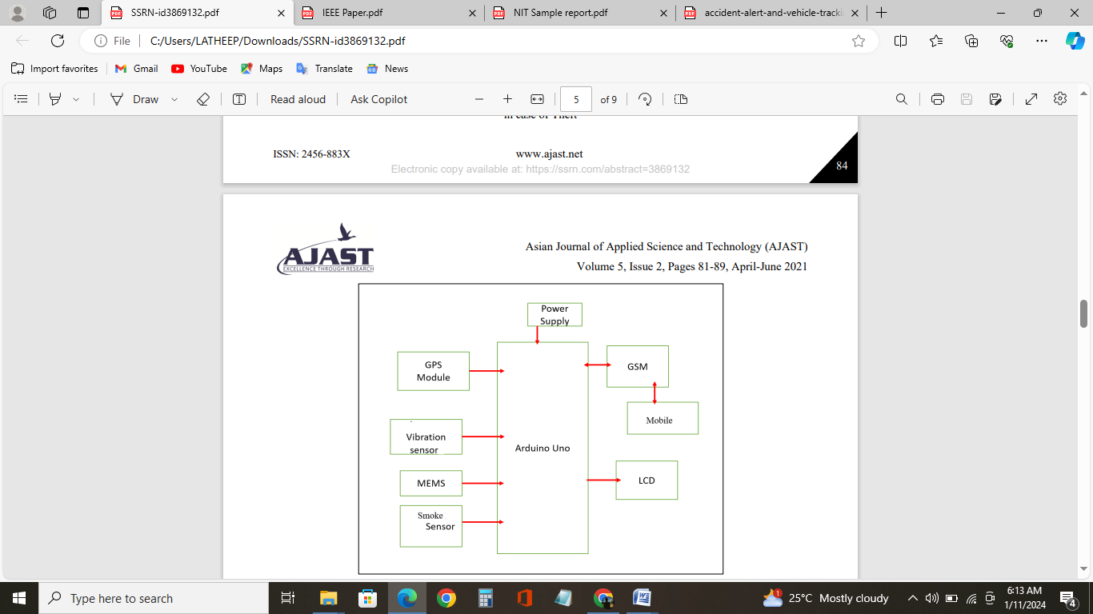
EXISTING METHOD
BLOCK DIAGRAM

Slide 8
PROPOSED WORK
DESCRIPTION
"Safety Route Shield" –An Advanced vehicle safety system powered by Intel Galileo Gen 2. Our project uses intelligent sensors like vibration, accelerometer, alcohol, GPS, GSM, and sound sensors for dynamic monitoring. In case of an accident, it swiftly sends an SMS with precise GPS location details when changes happens in accelerometer and vibration sensor. The alcohol sensor alerts against drunk driving, and the sound sensor ensures quick notifications by detecting impact sounds. Safety Route Shield is all about real-time monitoring, accident prevention, and encouraging responsible driving for a safer road experience.

Slide 9
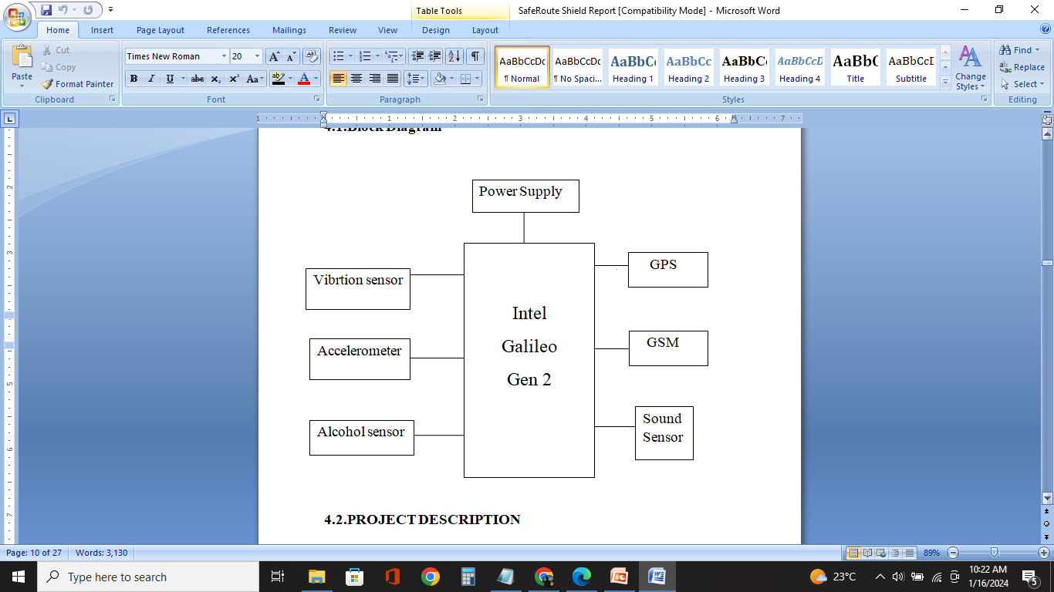
BLOCK DIAGRAM

Slide 10
ADVANTAGES
Accident Detection due to the combination of vibration, acceleration, and sound sensors ensures a comprehensive approach to accident detection.
Prevention of Drunk Driving - The alcohol sensor promotes road safety by alerting authorities when alcohol consumption is detected.
Intel Galileo Gen 2 offers a more powerful processing unit, potentially allowing for faster and more sophisticated data analysis and decision-making.
The use of Intel Galileo Gen 2 provides a platform that may offer better integration capabilities

Slide 11
HARDWARE
Intel Galileo Gen 2
MPU6050 Accelerometer
SW420 Vibration Sensor
NEO 6M GPS module
SIM800C GSM module
MQ3 Alcohol Sensor
LM393 Sound Sensor

Slide 12
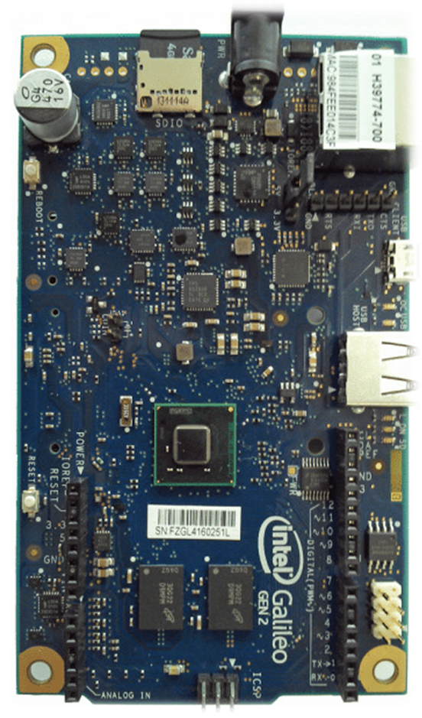
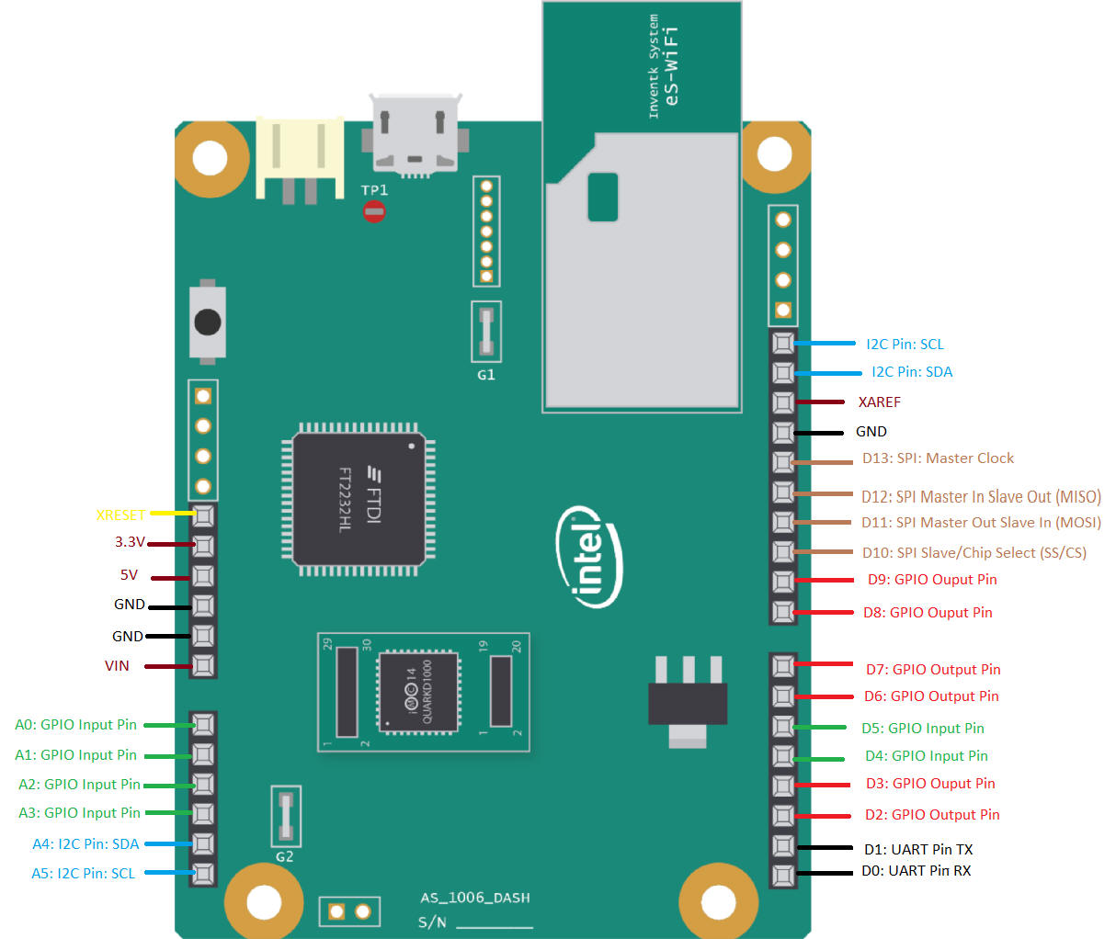
INTEL GALILEO GEN 2

Slide 13
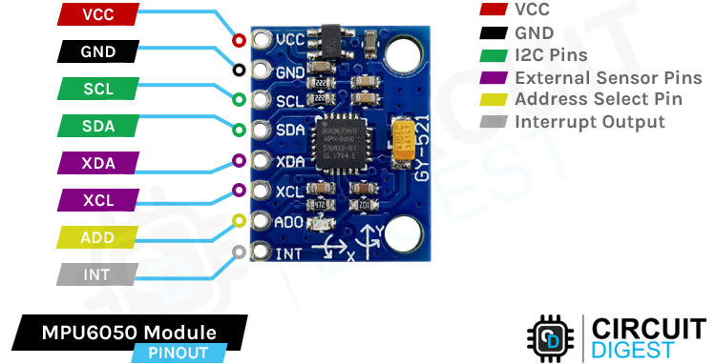
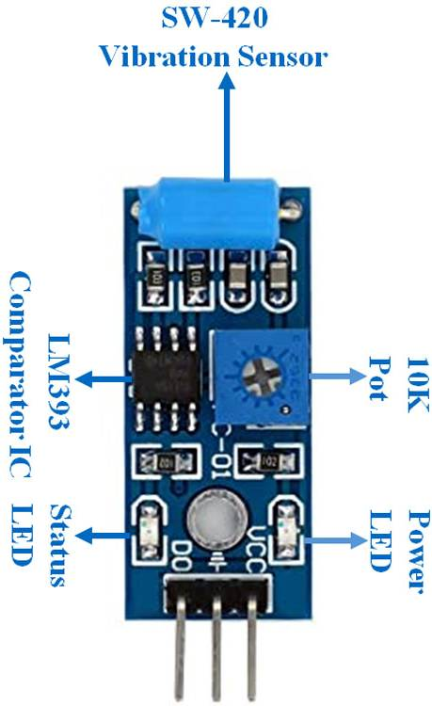
MPU6050 ACCELEROMETER
SW420 VIBRATION SENSOR

Slide 14
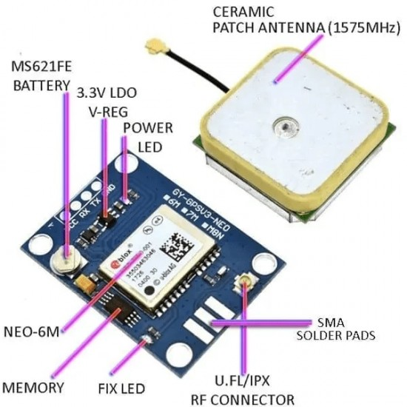
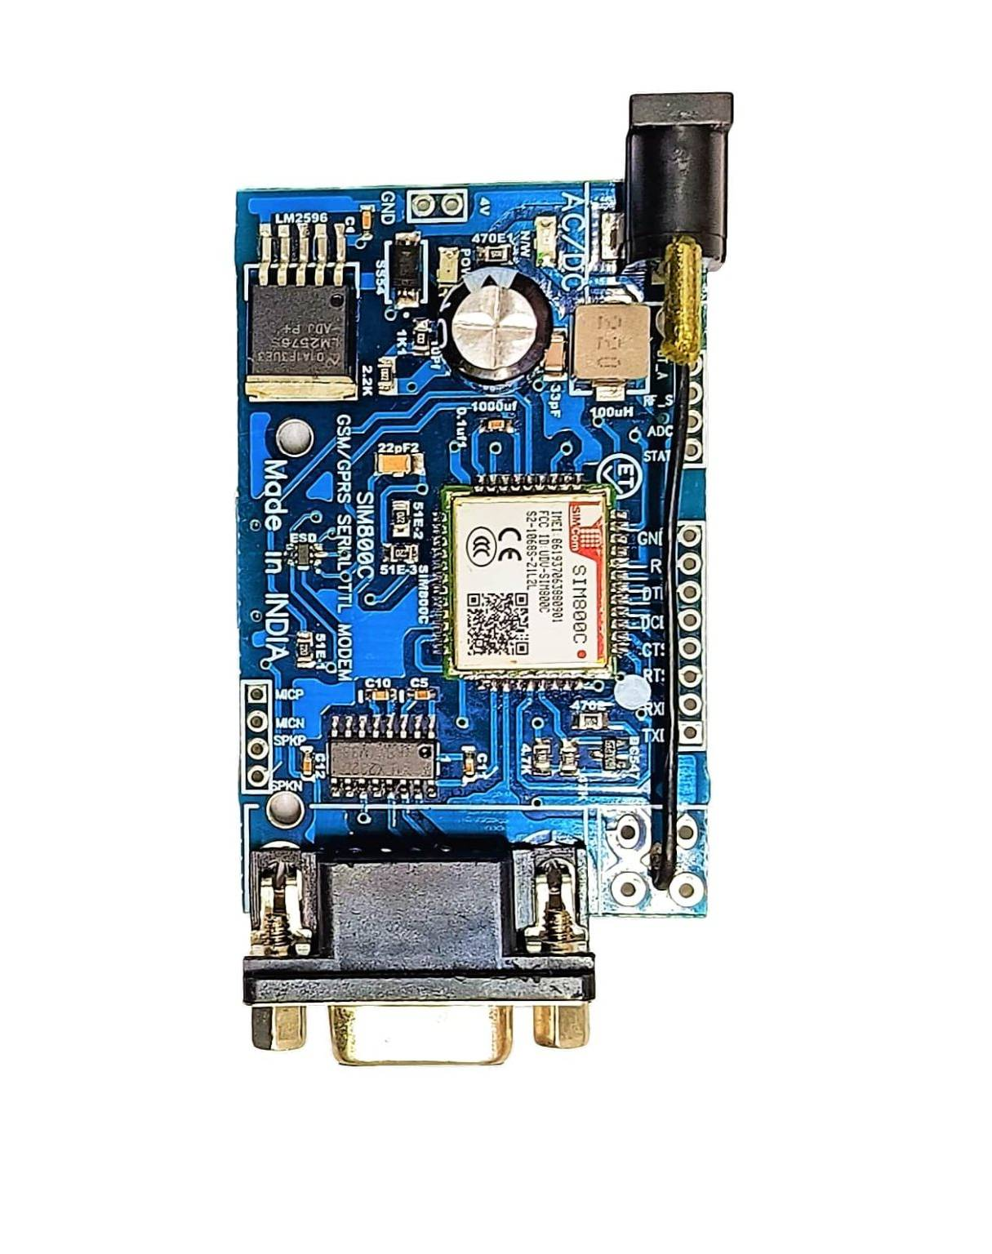
NEO 6M GPS MODULE
SIM800C GSM MODULE

Slide 15
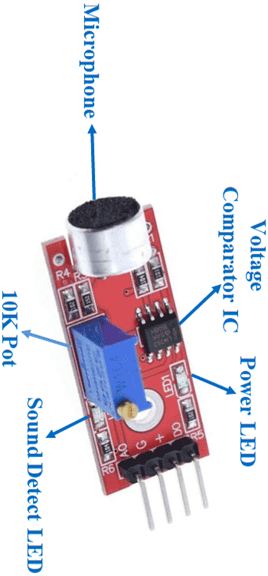
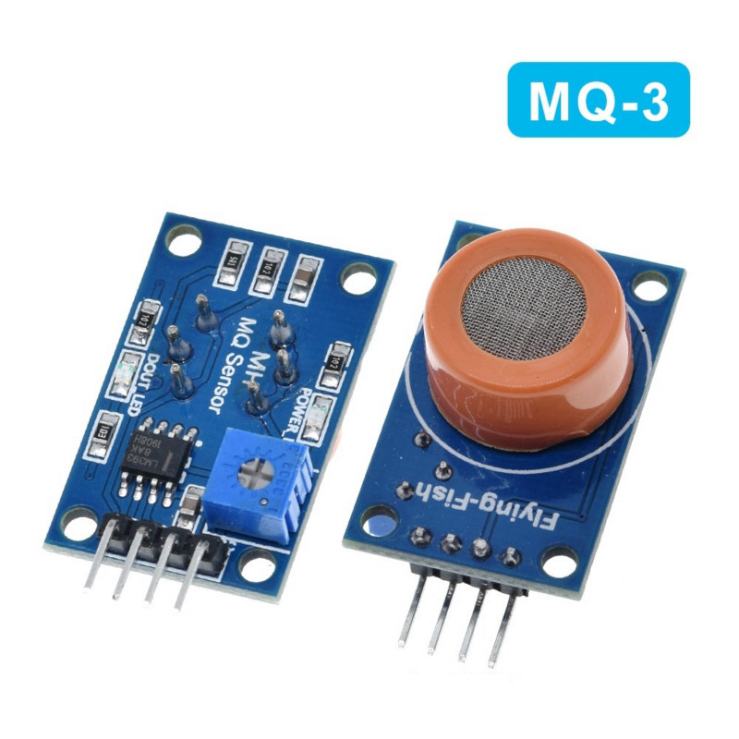
MQ3 ALCOHOL SENSOR
LM393 SOUND SENSOR

Slide 16
PIN CONFIGURATION
Intel Galileo Gen 2
  Pin 2: GPS TX
  Pin 3: GPS RX
  Pin 4: Vibration Sensor D0
  Pin A0: Alcohol Sensor A0
  Pin A1: Sound Sensor A0
  Pin RX: GSM TX
  Pin TX: GSM RX
Power Supply
  Connect 3.3V to GPS VCC
  Connect 5V to Vibration Sensor VCC, Alcohol Sensor VCC, Sound Sensor VCC, and GSM VCC
  Connect GND to GPS GND, Vibration Sensor GND, Alcohol Sensor GND, Sound Sensor GND, and GSM GND

Slide 17
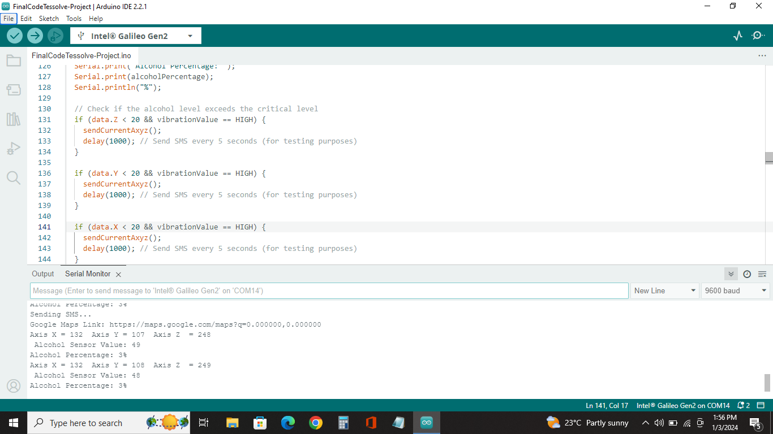
SOFTWARE
In our SafetyRoute Shield project, we employ the Arduino IDE for programming the Intel Galileo Gen 2, benefiting from its user-friendly interface and extensive library support. This combination streamlines functionality development, ensuring smooth integration between sensors and the Intel Galileo Gen 2.
The result is an efficiently programmed system capable of real-time accident detection and responsive SMS alerts for enhanced safety.

Slide 18
APPLICATIONS
Real-time Accident Detection
Drunk Driving Prevention
Road Safety Promotion
Efficient Emergency Response
Customizable Alert System

Slide 19
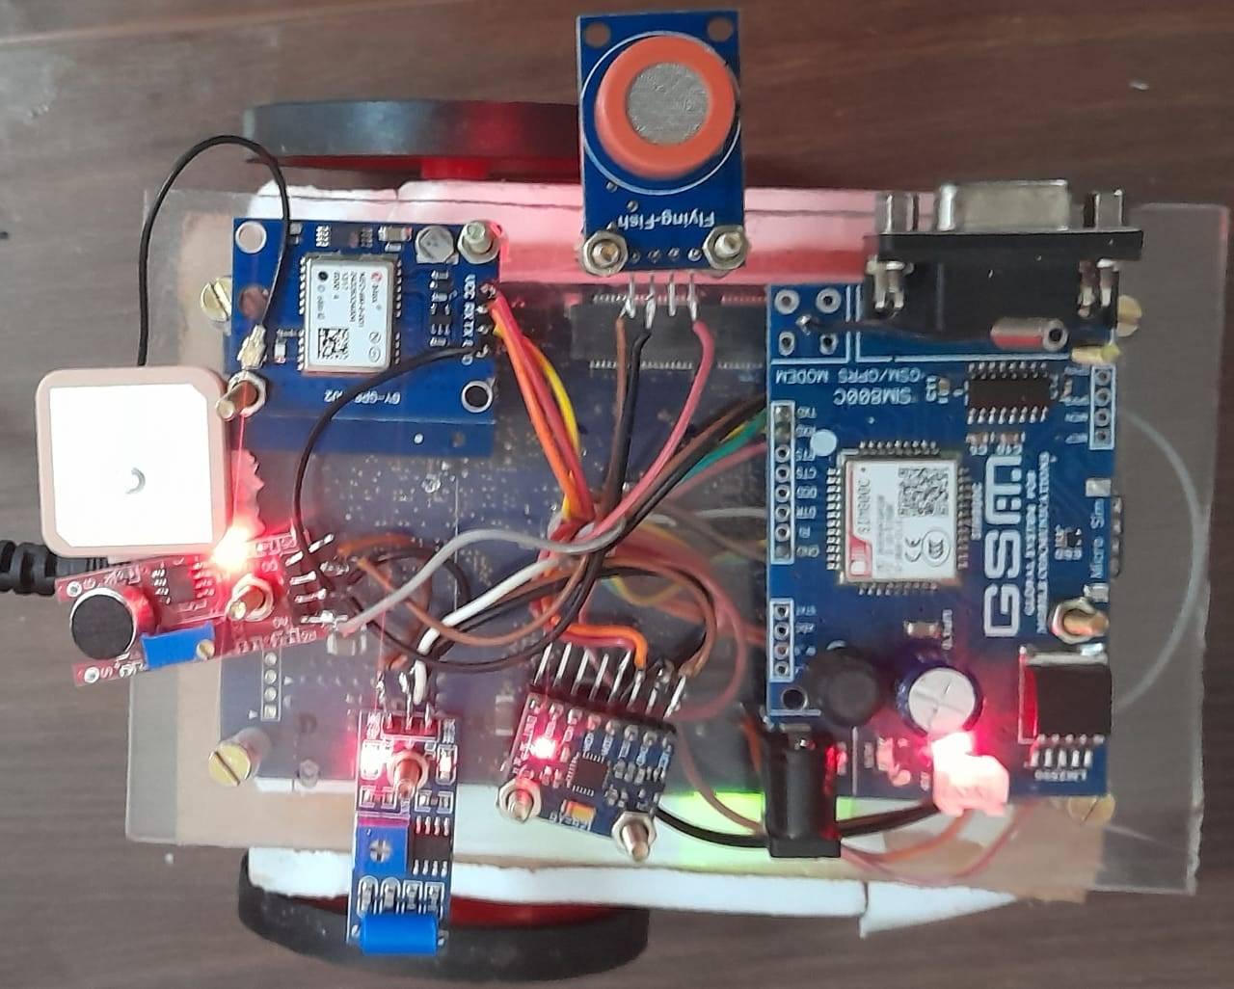
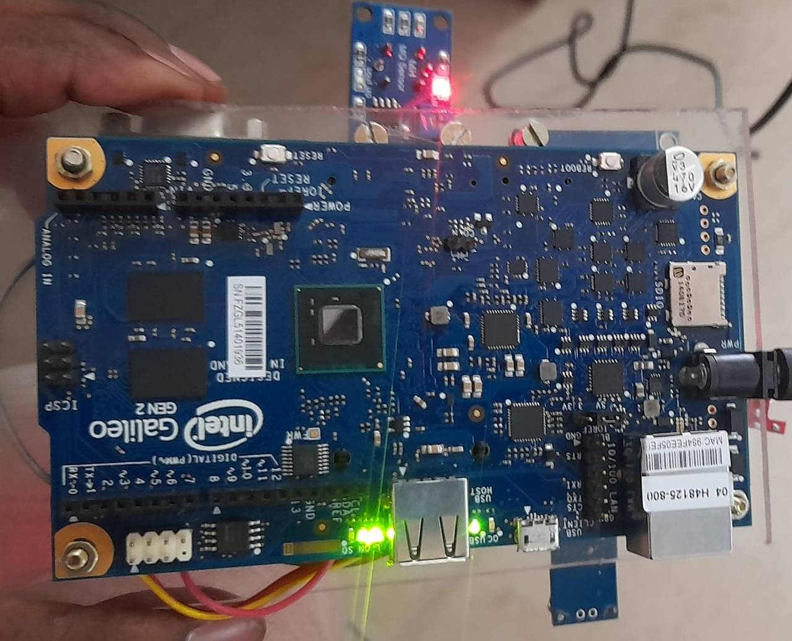
PROJECT DEMO
Project Demo Link https://drive.google.com/file/d/1dcUykhEq088nykj5_SzrSxAE82_JOHES/view?usp=drive_link

Slide 20
CONCLUSION
SafetyRoute Shield, powered by Intel Galileo Gen 2 and Arduino IDE, ensures real-time accident detection and responsible driving. Advanced sensors trigger swift SMS alerts with precise GPS details, enhancing road safety and discouraging drunk driving. This project demonstrates a commitment to leveraging technology for public safety, offering a practical tool for accident prevention and rapid emergency response on the roads.

Slide 21
REFERENCES
Racheal Dias, Vishakha Ghike, Jennifer Johnraj, Nicholas Fernandes, Anita Jadhav Department of Electronics and Telecommunication, Fr. Conceicao Rodrigues Institute of Technology, Vashi, Navi Mumbai, India
2. Dr. Avinash Chandra, Rishab Kaul, Shaanvi Mehta, Subharthi
Saha Vellore Institute of Technology
3. J. Mounika¹ , N. Charanjit², B. Saitharun³ & B. Vashista4
Assistant Professor¹, Dept. of ECE, Chaitanya Bharathi Institute of
Technology, Osmania University, Hyderabad, Telangana, India. 2,3,4
B.E Scholar, Dept. of ECE, Chaitanya Bharathi Institute of
Technology, Osmania University, Hyderabad, Telangana, India.

